Slide 1
Overview of Automated ML
Place name here

Slide 2

Agenda
Why Automated Machine Learning?
Capabilities: What’s New?
Demos
Enterprise Deployment
Q&A

Slide 3
Why Automated ML?

Slide 4








Machine Learning on Azure
Domain Specific Pretrained Models
To reduce time to market
…
Vision
Speech
Language
Search
Familiar Data Science Tools
To simplify model development
PyCharm
Jupyter
Visual Studio Code
Command line
Popular Frameworks
To build machine learning and deep learning solutions
PyTorch
TensorFlow
Scikit-Learn
ONNX
Productive Services
To empower data science and development teams
Azure Databricks
Azure Machine Learning
Machine Learning VMs
Powerful Hardware
To accelerate deep learning
CPU
GPU
FPGA
From the Intelligent Cloud to the Intelligent Edge
Notes:
Azure cognitive search provides some pretrained model such as vision, speech and language which you can use for translation or searching on a webpage.
There are also some familiar data science tools suchs pycharm, juypter notebooks which we will discuss more in a couple slides
There some popular frameworks pytorch, tensorflow
We have a few productive services and we will focus on azure machine learning.
And there are many options you can use for compute when running automated ml.

Slide 5
Building blocks for a Data Science Project
Build and train models
Hyperparameter tuning
Experimentation and pipelines
Deployment
DevOps for data science
Classical ML
Data sources
Deep learning

Slide 6
What is automated machine learning?
Automated machine learning (automated ML) automates feature engineering, algorithm and hyperparameter selection to find the best model for your data.

Slide 7
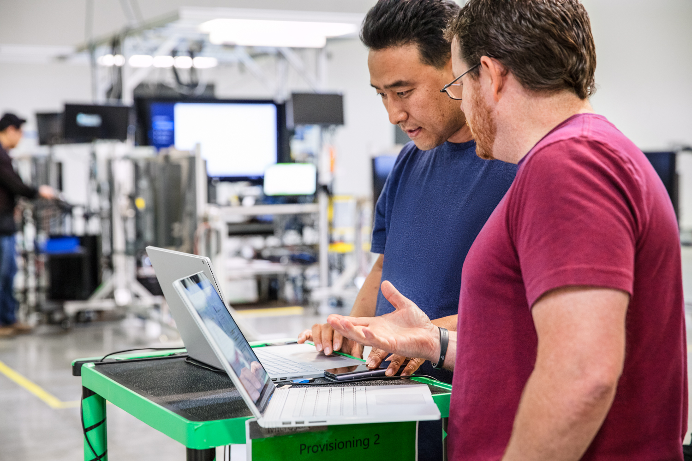


Automated ML Mission
Enable automated building of machine learning with the goal of accelerating, democratizing and scaling AI
Democratize AI
Accelerate AI
Scale AI
Enable Domain Experts & Developers to get rapidly build AI solutions
Improve Productivity for Data Scientists, Citizen Data Scientists, App Developers & Analysts
Build AI solutions at scale in an automated fashion
Notes:
Once you have your data source and format defined. You need to consider how you want the experiment to split your train, test and validation data. Automated ML supports three types.
K-fold
Monte Carlo or repeated random sub-sampling
Manual or custom splits.
K-Fold
For k-fold use n_cross_validations setting to specify the number of cross validations. The training data set will be randomly split into n_cross_validations folds of equal size. During each cross-validation round, one of the folds will be used for validation of the model trained on the remaining folds. This process repeats for n_cross_validations rounds until each fold is used once as validation set. The average scores across all n_cross_validations rounds will be reported, and the corresponding model will be retrained on the whole training data set.
Monte Carlo
Use validation_size to specify the percentage of the training dataset that should be used for validation, and use n_cross_validations to specify the number of cross validations. During each cross validation round, a subset of size validation_size will be randomly selected for validation of the model trained on the remaining data. Finally, the average scores across all n_cross_validations rounds will be reported, and the corresponding model will be retrained on the whole training data set.
Custom Validation Dataset
Use custom validation if random split is not acceptable (usually time series data or imbalanced data). You can specify your own validation dataset. The model will be evaluated against the validation dataset specified instead of random dataset. If you are using custom splits you split you would split your data based on your requirements and pass your training data into the x and y parameters and x_valid and y_valid for validation data.

Slide 8
Machine Learning Problem Example
How much is this car worth?

Slide 9
Model Creation Is Typically Time-Consuming
Which features?
Which algorithm?
Which parameters?
Mileage
Condition
Car brand
Year of make
Regulations
…
Gradient Boosted
Nearest Neighbors
SVM
Bayesian Regression
LGBM
…
Parameter 1
Parameter 2
Parameter 3
Parameter 4
…
Mileage
Gradient Boosted
Criterion
Loss
Min Samples Split
Min Samples Leaf
Others
Car brand
Year of make
30%
Model

Slide 10
Model Creation Is Typically Time-Consuming
Which features?
Which algorithm?
Which parameters?
Mileage
Condition
Car brand
Year of make
Regulations
…
Gradient Boosted
Nearest Neighbors
SVM
Bayesian Regression
LGBM
…
Criterion
Loss
Min Samples Split
Min Samples Leaf
Others
Mileage
Gradient Boosted
N Neighbors
Weights
Metric
P
Others
Condition
Nearest Neighbors
Car brand
Car brand
50%
Year of make
30%
Year of make
Model
Iterate

Slide 11
Model Creation Is Typically Time-Consuming
Which features?
Which algorithm?
Which parameters?
30%
50%
70%
30%
45%
50%
65%
95%
35%
10%
75%
20%
70%
30%
15%
Iterate

Slide 12
Automated ML Accelerates Model Development
Input
Intelligently test multiple models in parallel
Output
25%
Optimized model
25%
40%
Enter data
70%
25%
40%
70%
95%
95%
Define goals
25%
40%
70%
25%
40%
25%
70%
Apply constraints
40%

Slide 13
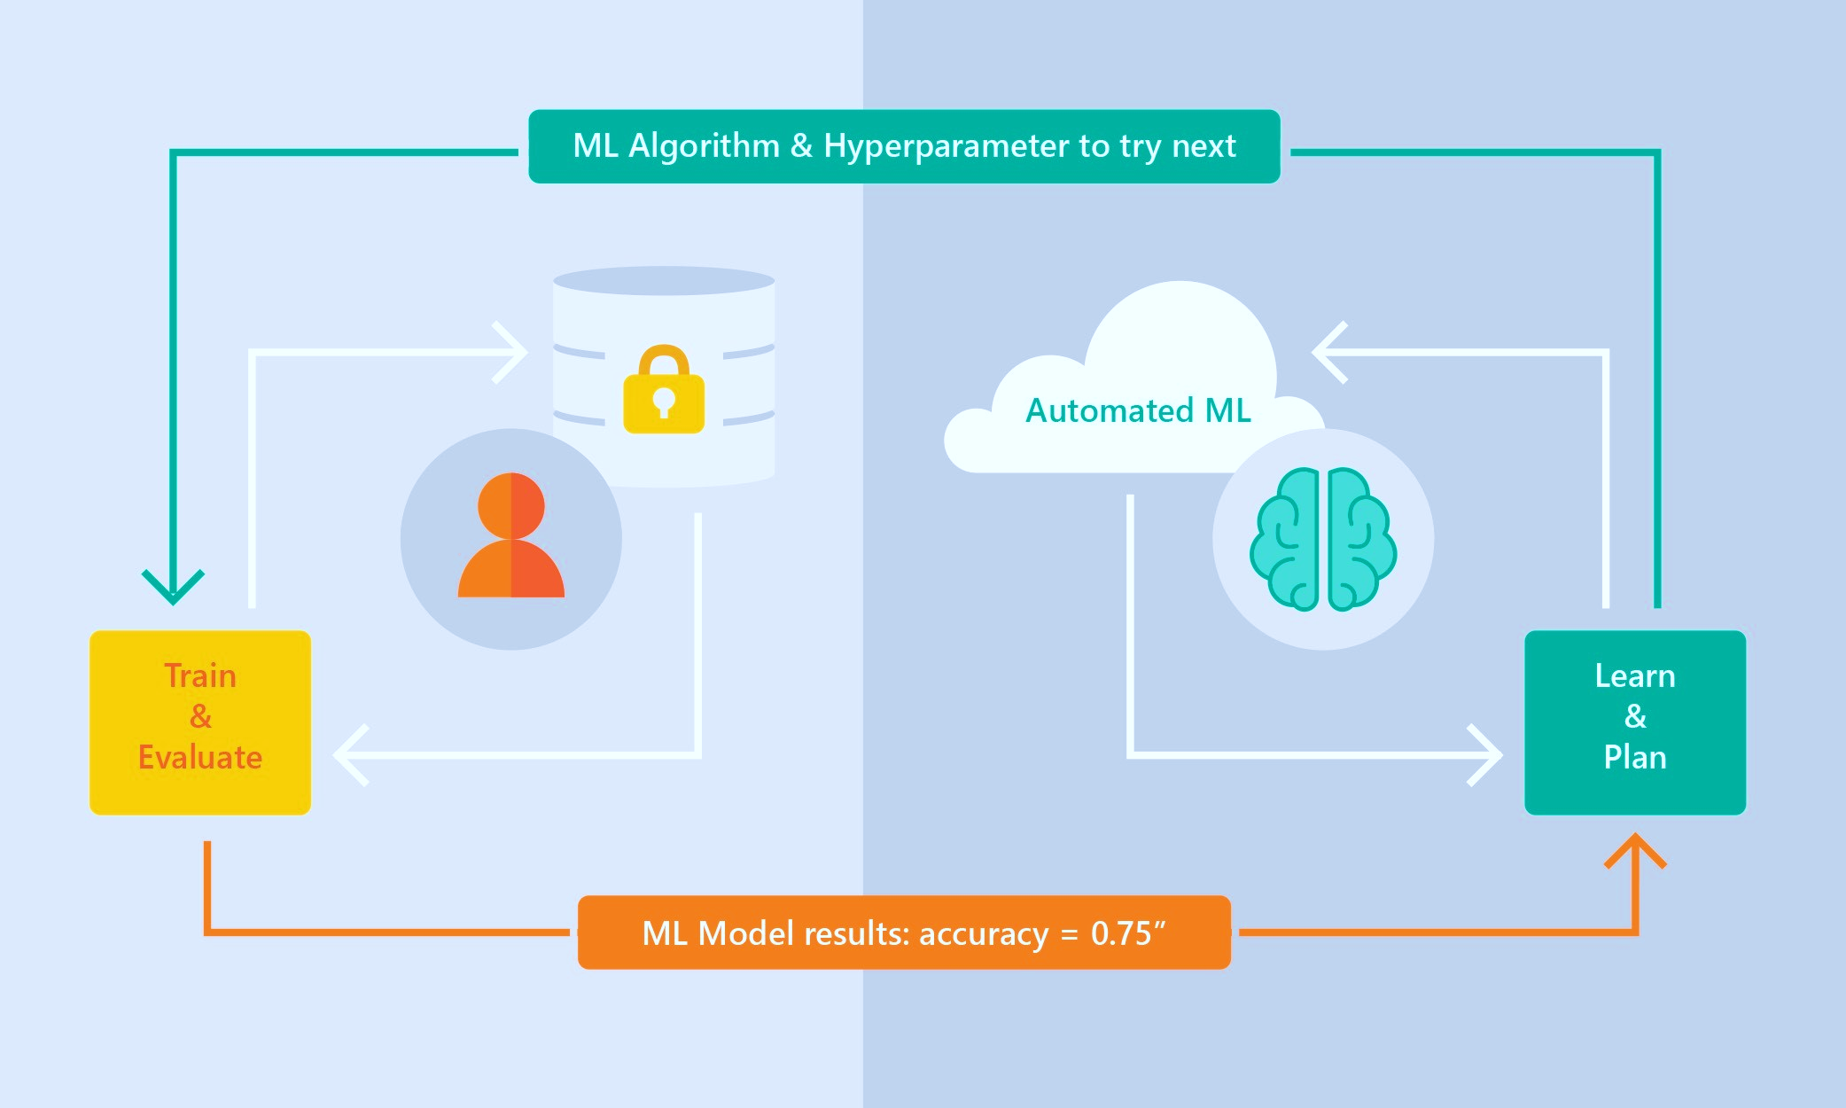
Automated ML Capabilities
Based on Microsoft Research
Brain trained with several million experiments
Collaborative filtering and Bayesian optimization
Privacy preserving: No need to “see” the data

Slide 14
Automated ML Capabilities
ML Scenarios: Classification & Regression, Forecasting
Languages: Python SDK for deployment and hosting for inference – Jupyter notebooks
Training Compute: Local Machine, AML Compute, Data Science Virtual Machine (DSVM), Azure Databricks*
Transparency: View run history, model metrics, explainability*
Scale: Faster model training using multiple cores and parallel experiments
* In Preview

Slide 15
Guardrails
Class imbalance
Train-Test split, CV, rolling CV
Missing value imputation
Detect high cardinality features
Detect leaky features
Detect overfitting
Model Interpretability / Feature Importance

Slide 16
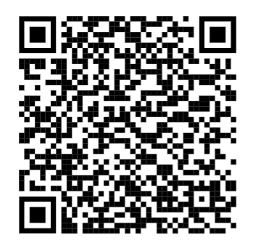
What’s new?

Slide 17
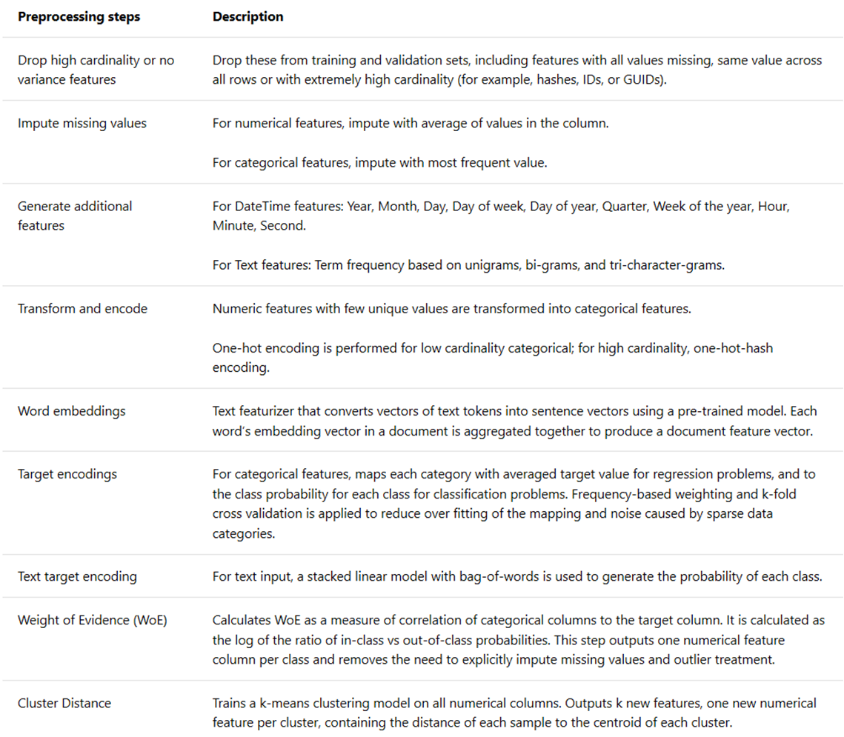
Latest announcements @ MS Build (Blog post with all the announcements)
Feature engineering updates
Additional data guardrails and synthetic features
Added XGBoost algorithm
Improved transparency retrieving the engineered features
Coming up next
Improved feature sweeping, text featurization
Transparency: Get auto-featurized data

Slide 18

Latest announcements @ MS Build (Blog post with all the announcements)
Time Series Forecasting Generally Available
Rolling cross validation splits for time series data
Configurable lags
Window aggregation
Holiday featurizer

Slide 19
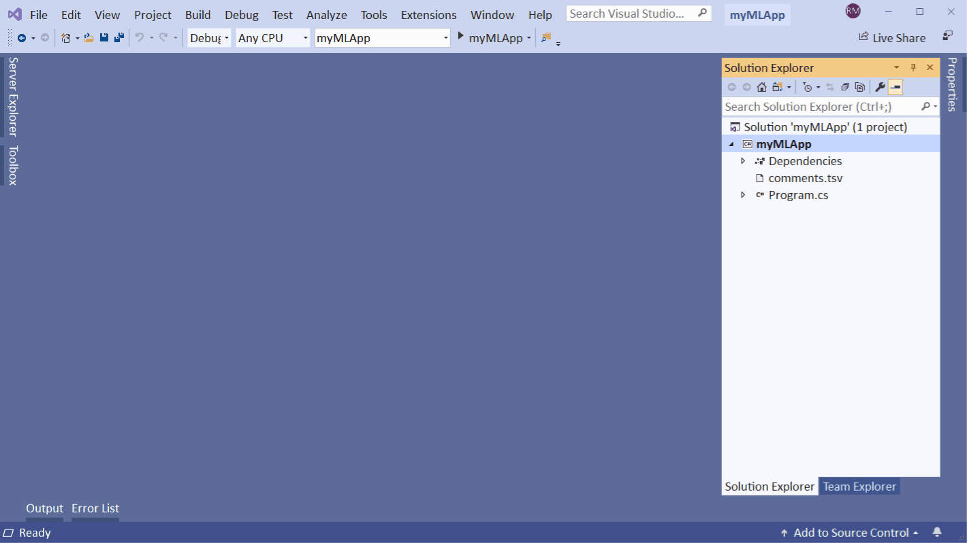
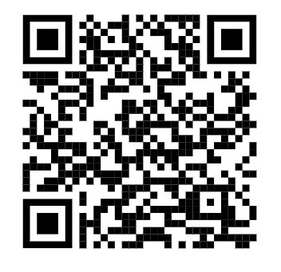
Latest announcements @ MS Build (Blog post with all the announcements)
Automated ML in ML.NET Model Builder (Preview)
Train ML models from Visual Studio
Inference from your application
ML.NET Model Builder

Slide 20
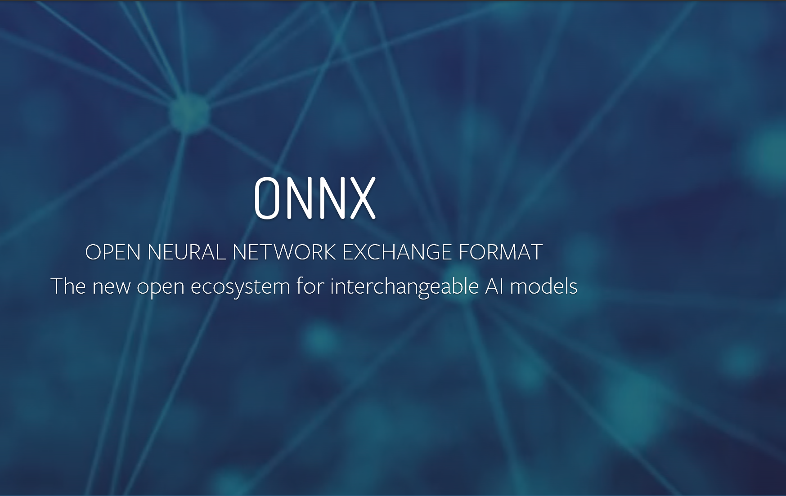

Latest announcements @ MS Build (Blog post with all the announcements)
ONNX support
Automated ML output ONNX format models
Inferencing support for C# apps via ONNX runtime environments (WinML, ML.Net, ONNX C# API), Cosmos pipelines

Slide 21
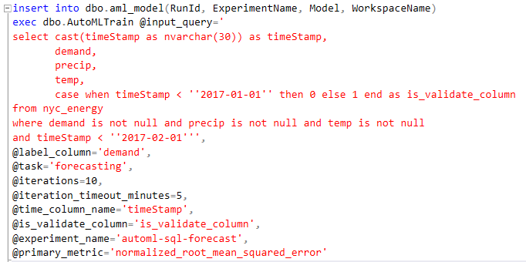
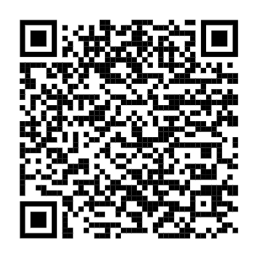
Latest announcements @ MS Build (Blog post with all the announcements)
Run automated ML from SQL
Blog post

Slide 22
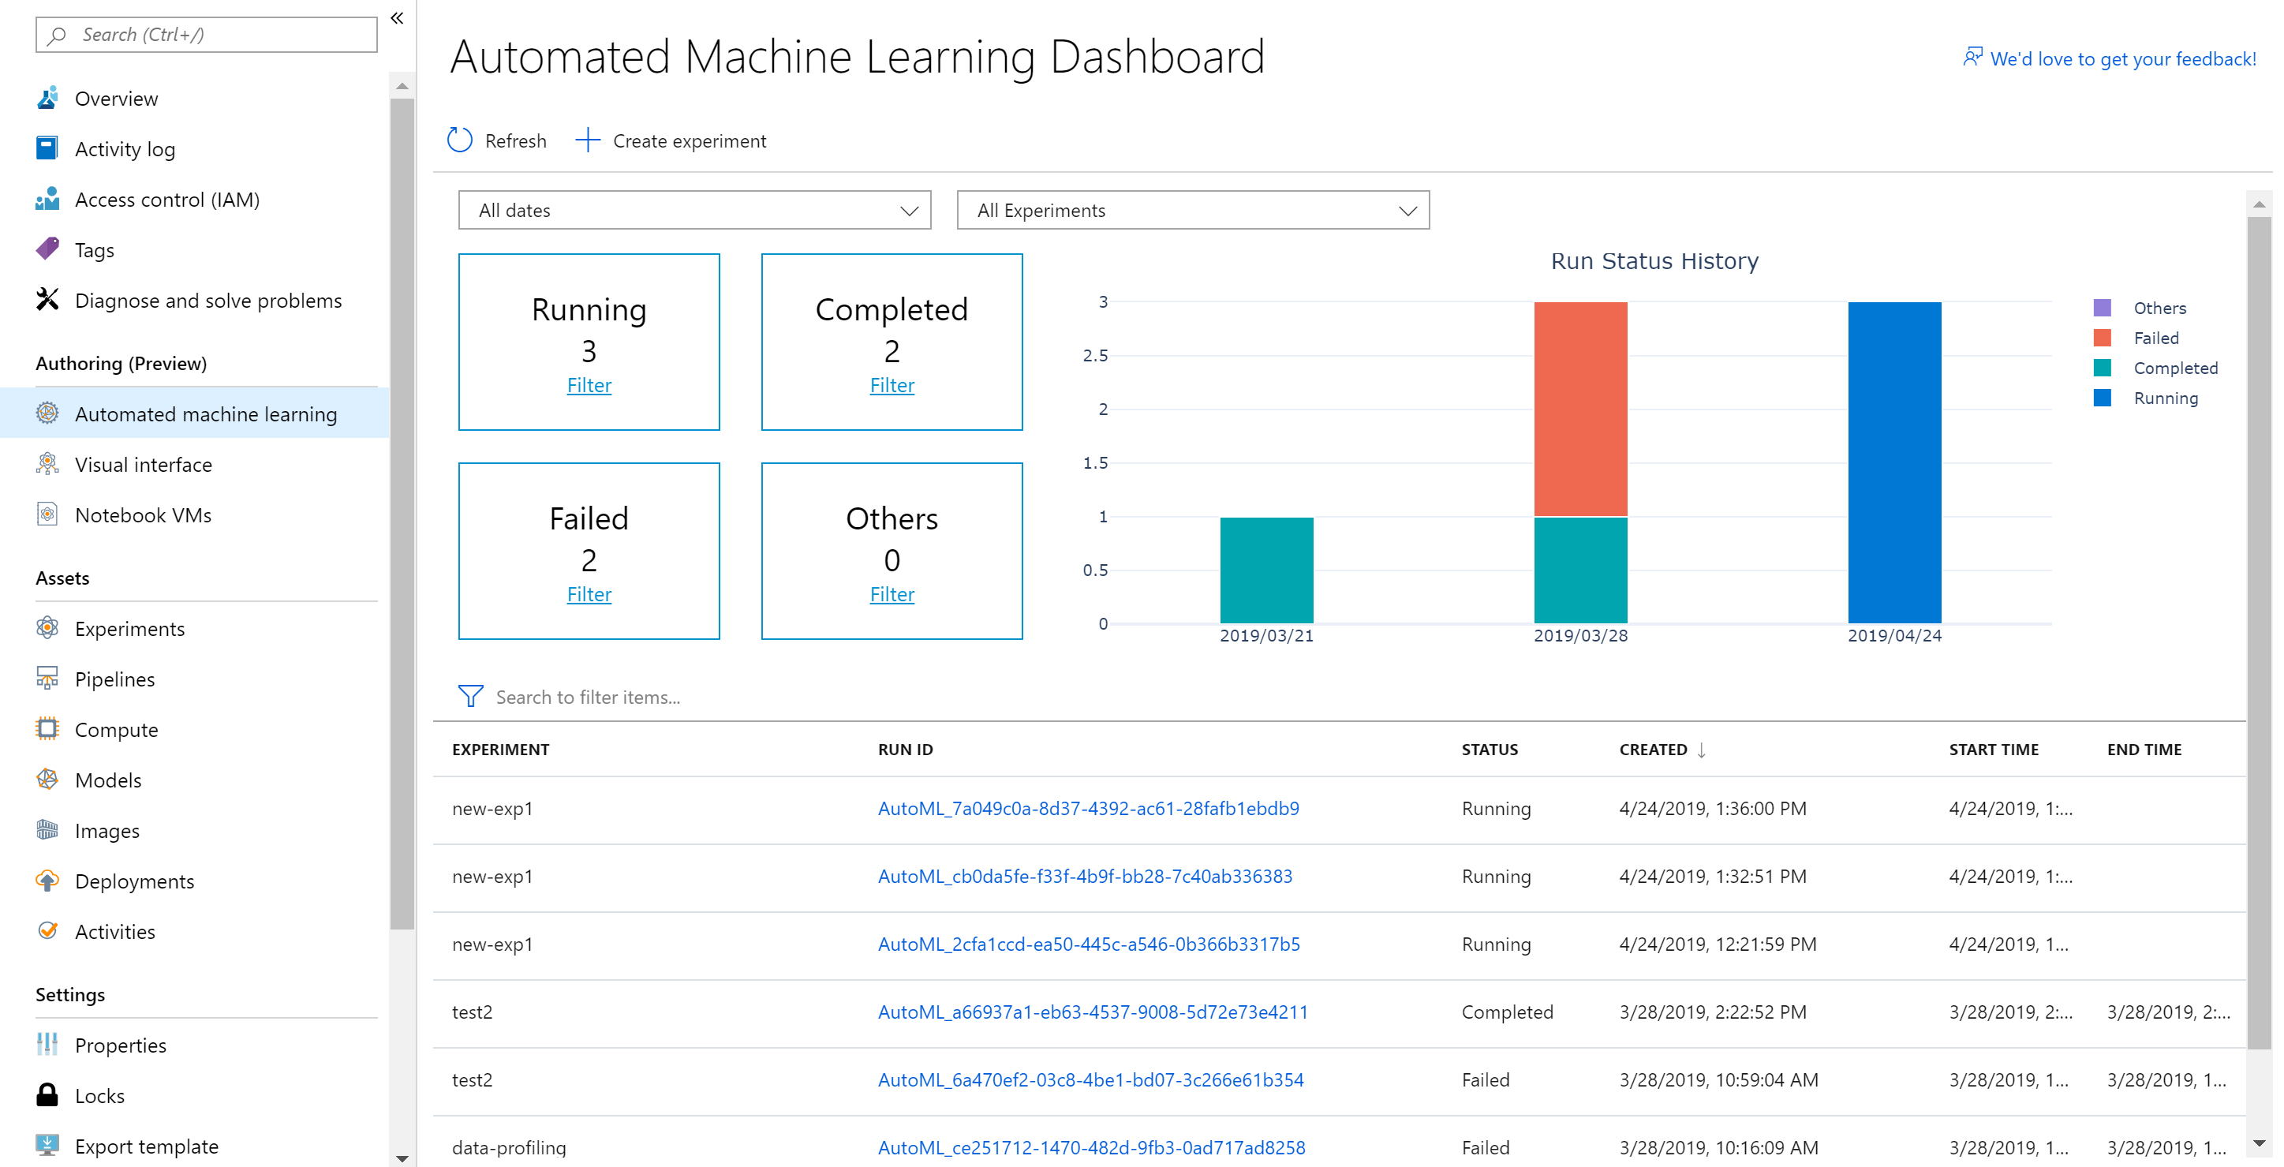
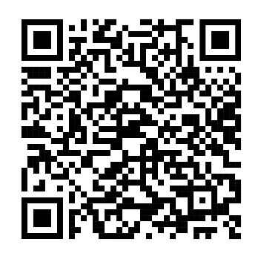
Latest announcements @ MS Build (Blog post with all the announcements)
Automated ML UI in Azure portal (Preview)
End-to-end no-code experience for non-data scientists to train ML models
Classification, Regression, Forecasting
Deploy models easily and quickly
Advanced settings for power users to tune the training job
Blog post
Coming up next
Model explainability
Additional data sources (with Datasets)
Re-run experiments

Slide 23
Demo: Azure Machine Learning Service

Slide 24
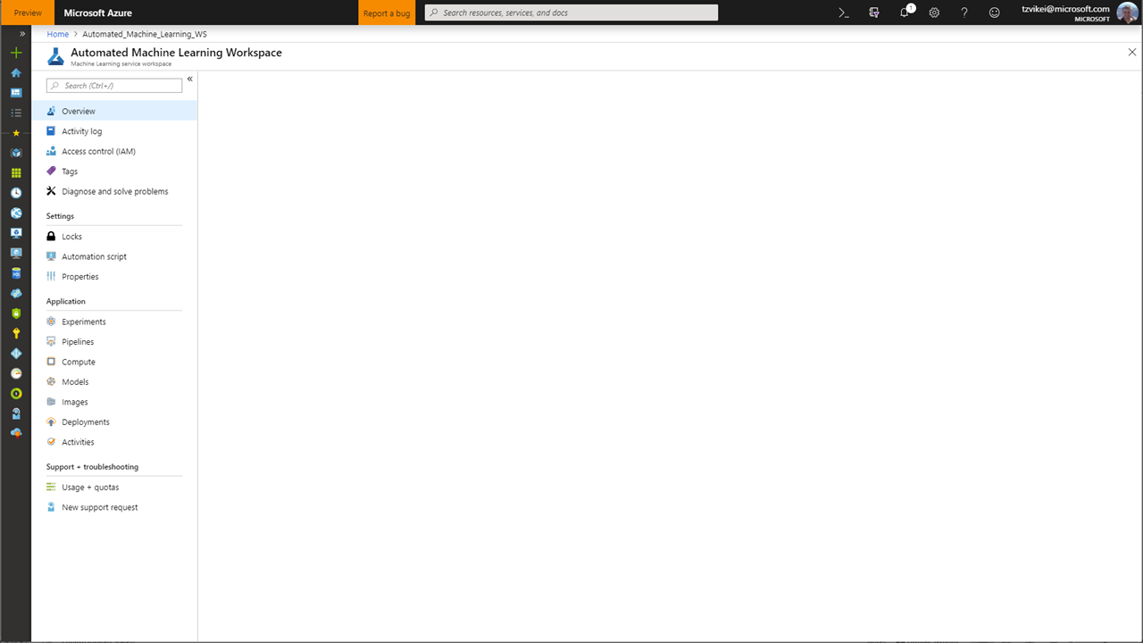
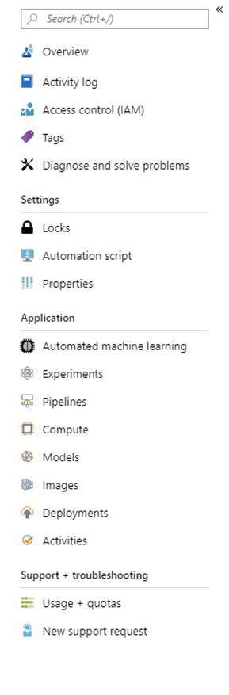
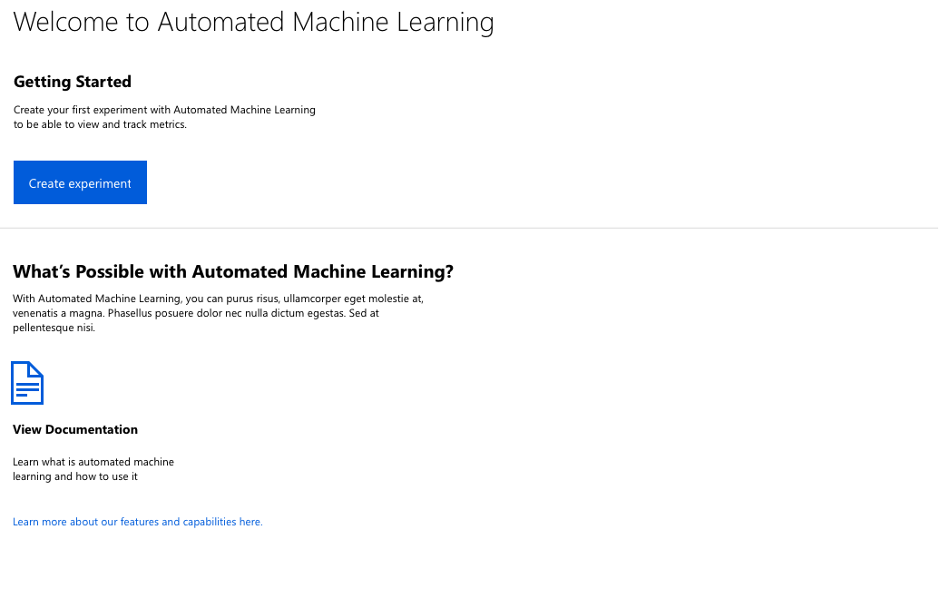
“Day 0” (First time) experience
Create your first experiment with automated machine learning to produce quality models with zero effort
Automate the process of algorithm selection, hyperparameter tuning, and best model selection with automated machine learning, and accelerate your productivity. Select your data and let automated ML do the rest to provide the best model from endless possible options

Slide 25
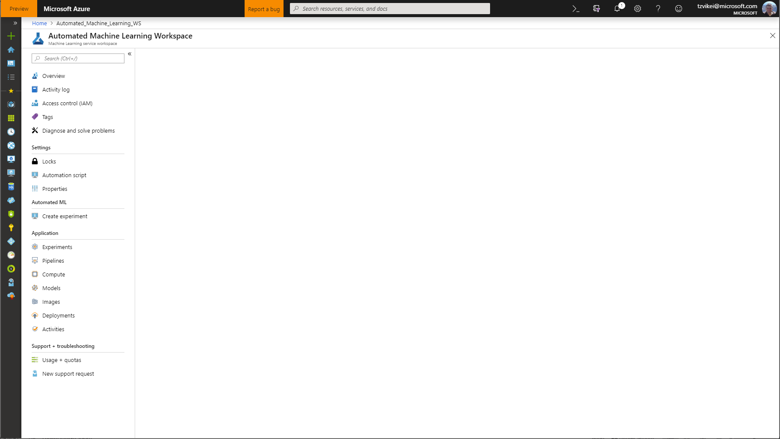
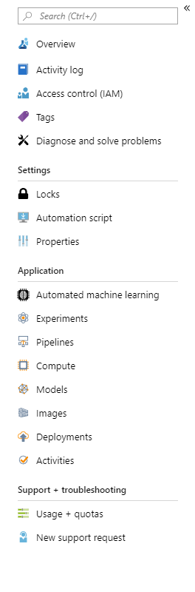
Create a new automated machine learning experiment
* Experiment name
myfirstautomlexperiment
*
Training compute 
amlcompute-4a57de20b3f1
Create new
Cancel
Next

Slide 26

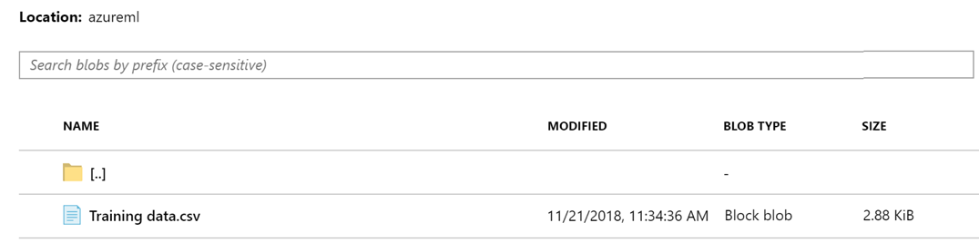

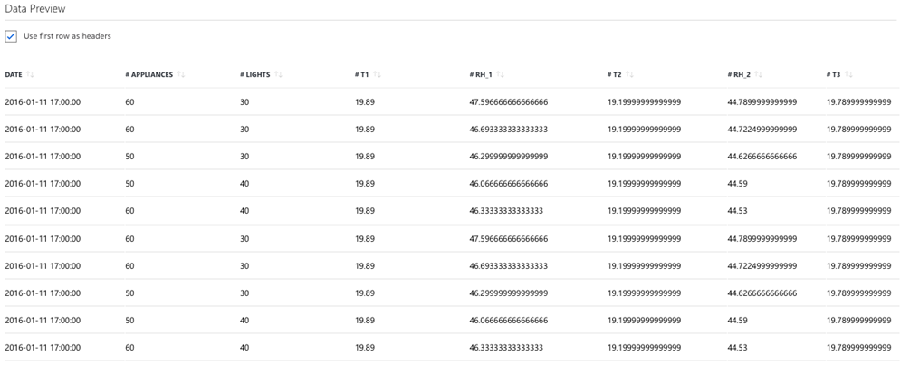
Create a new automated machine learning experiment
* Experiment name
myfirstautomlexperiment
*
Training compute 
Select existing…
Create new
Select a file from Azure blob storage account
* Storage account
mytestmlexperimentsto…
* Container
automl-blob-d8b2d4df-…
Select a storage account and a container to view the files list
Data Preview
Data Profile
Use first row as header
Include in training
Include in training
Include in training
Include in training
Include in training
Include in training
Include in training
Include in training

Slide 27

Data Preview
Data Profile
Include in training
Include in training
Include in training
Include in training
Include in training
Include in training
Include in training
Include in training
Training job settings:
* Training job type 
Classification
* Target column 
Freight cost
* Primary metric 
Accuracy
Number of iterations:
100
Notes:
TS?

Slide 28

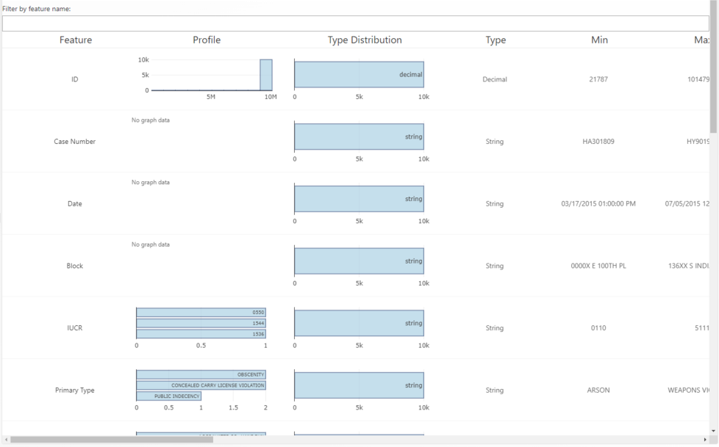
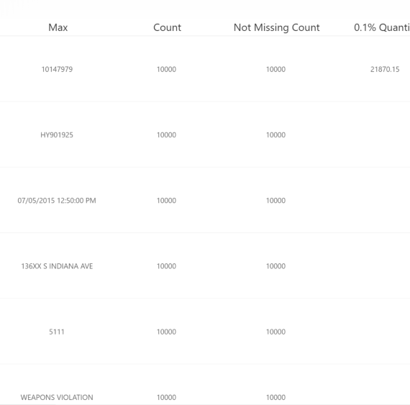
Data Preview
Data Profile
Data Preview
Data Profile
Condensed view
Include in training
Include in training
Include in training
Include in training
Include in training
Include in training
Include in training
Include in training
Training job settings:
* Training job type 
Classification
* Target column 
Freight cost
* Primary metric 
Accuracy
Number of iterations:
100
Notes:
TS?

Slide 29
Training job settings:
* Training job type 
Classification
* Target column 
Freight cost
* Primary metric 
Accuracy
Number of iterations:
100
Cancel
Start
Notes:
TS?

Slide 30
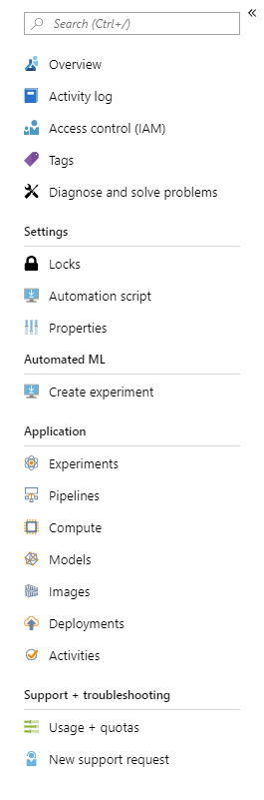
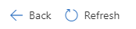
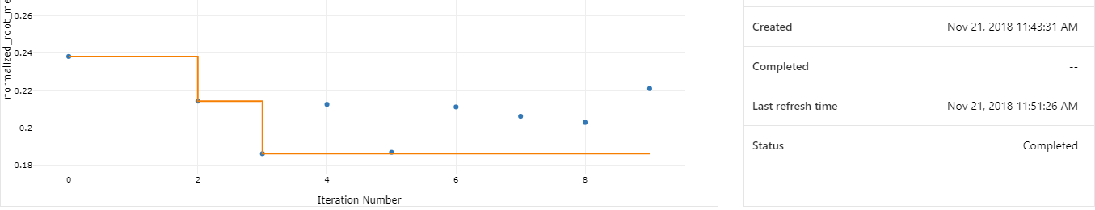
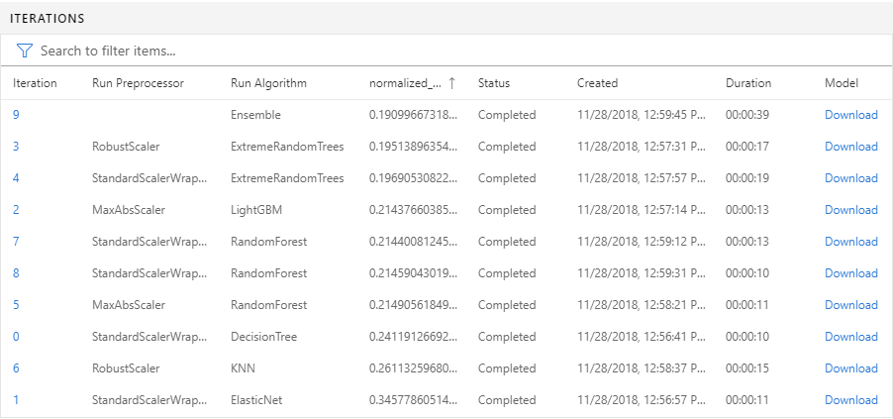
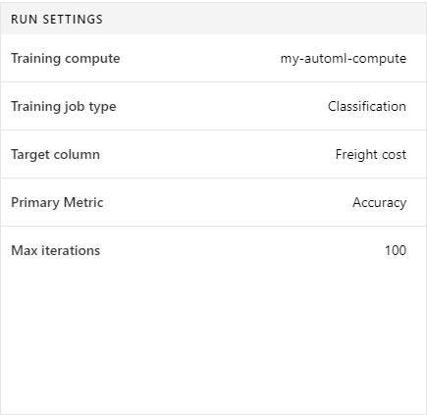
Myfirstautomlexperiment | Run #XXX

Slide 31
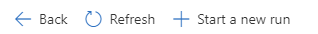
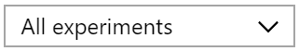

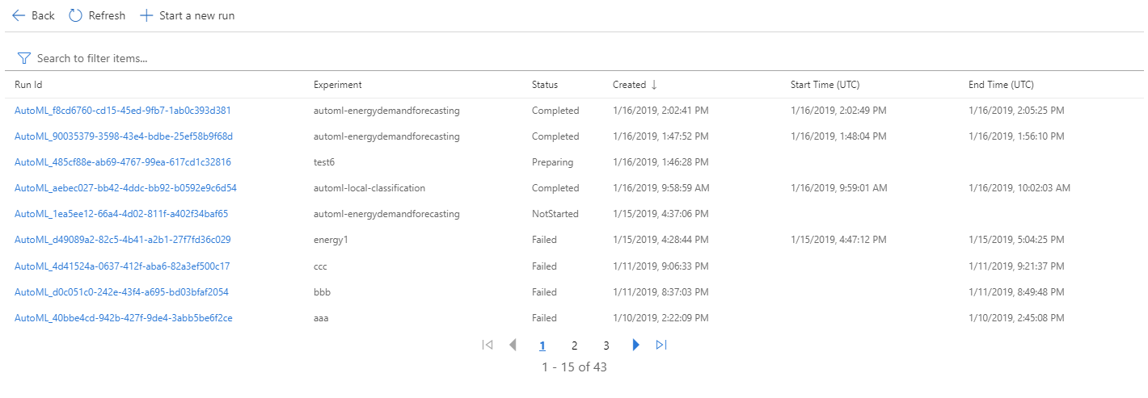
“Day 30” experience
Automated machine learning dashboard
All dates
#
Running
#
Completed
#
Failed
#
Cancelled

Slide 32
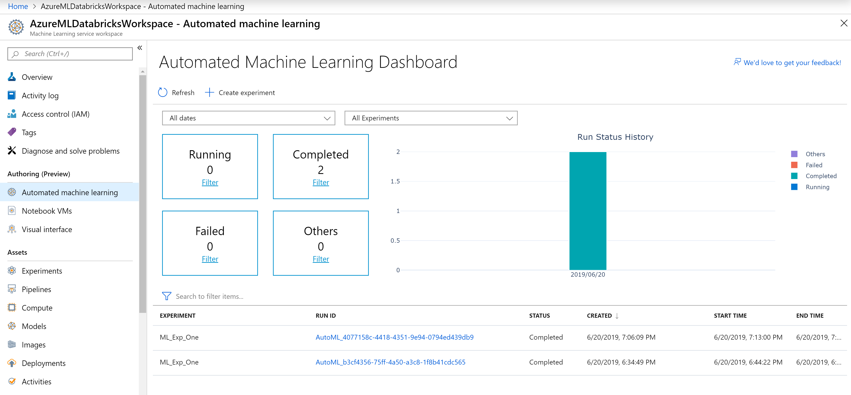
MarkTab Run

Slide 33
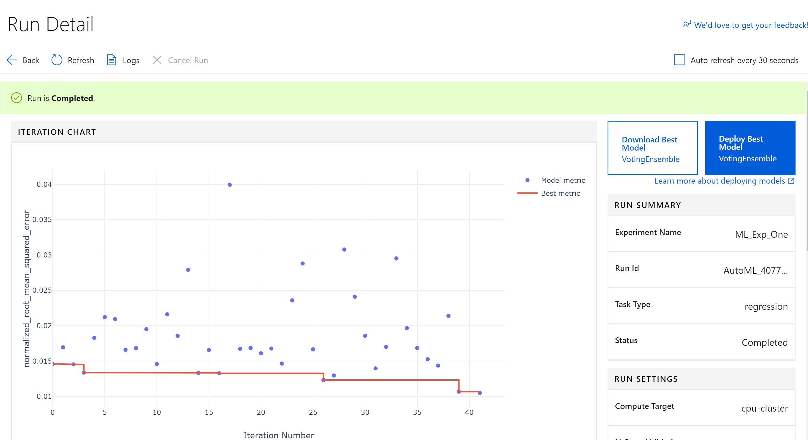

Slide 34
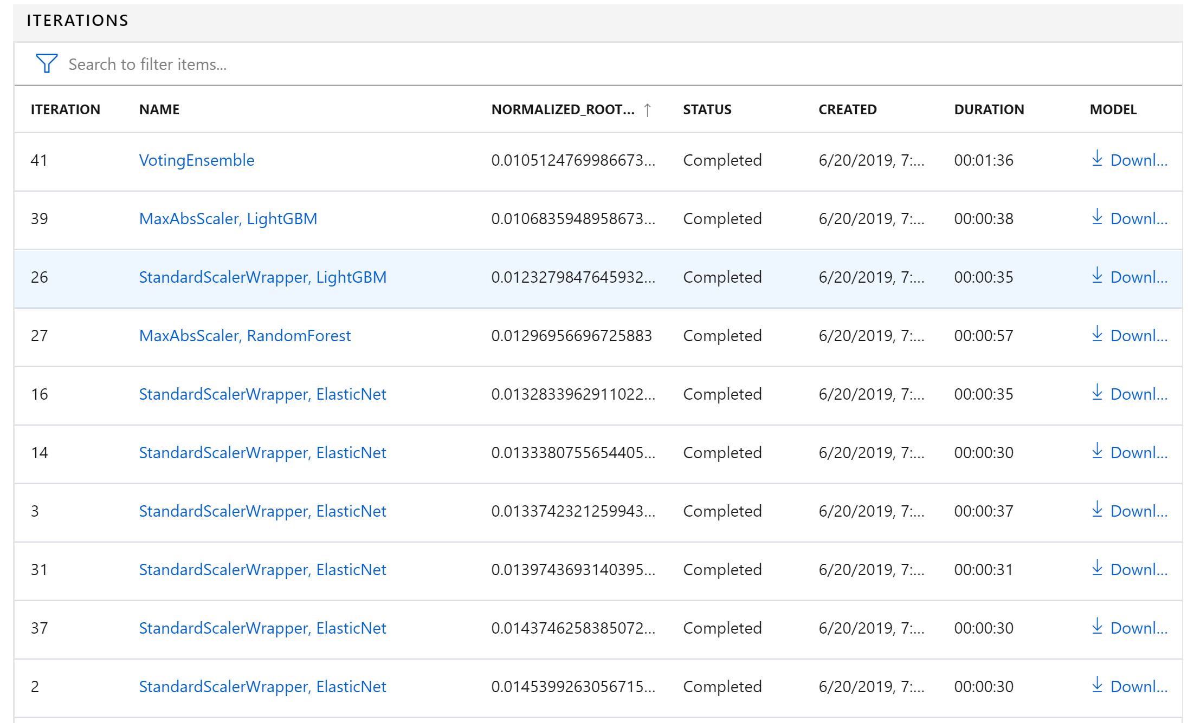

Slide 35
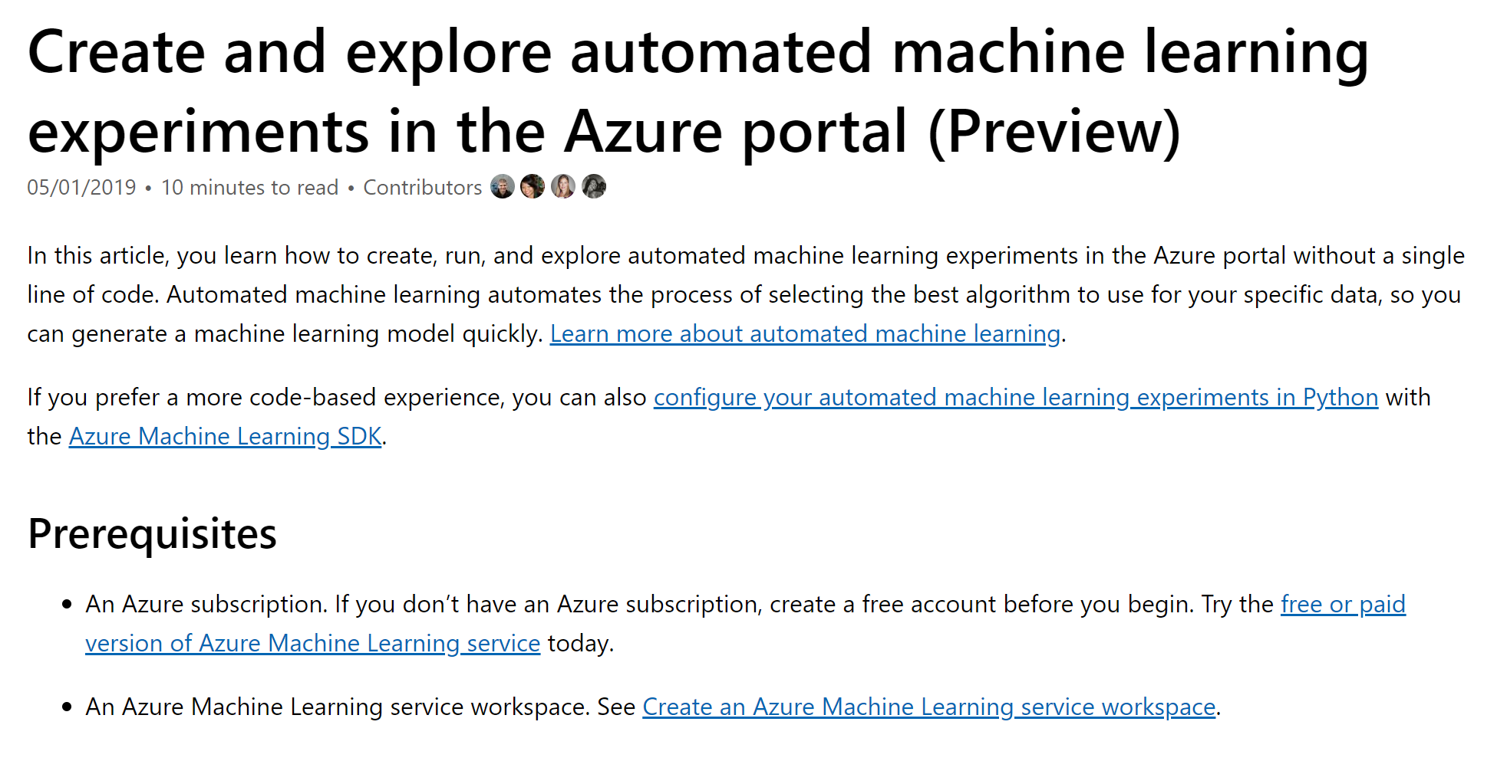
https://aka.ms/ai-automlazure

Slide 36
Demo: Azure Databricks

Slide 37
About Azure Databricks
Azure Databricks is a managed Spark offering on Azure and customers already use it for advanced analytics.
It provides a collaborative Notebook based environment with CPU or GPU based compute cluster.

Slide 38
Azure Databricks Features
Customers who use Azure Databricks for advanced analytics can now use the same cluster to run experiments with or without automated machine learning.
You may keep the data within the same cluster.
You may leverage the local worker nodes with autoscale and auto termination capabilities.
You may use multiple cores of your Azure Databricks cluster to perform simultaneous training.
You may further tune the model generated by automated machine learning.
Every run (including the best run) is available as a pipeline, which you may tune further if needed.
The model trained using Azure Databricks can be registered in Azure ML SDK workspace and then deployed to Azure managed compute (ACI or AKS) using the Azure Machine learning SDK.

Slide 39
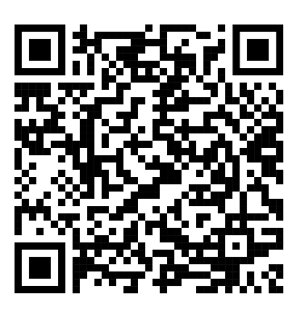
Github Demo
https://github.com/Azure/MachineLearningNotebooks/tree/master/how-to-use-azureml/azure-databricks

Slide 40
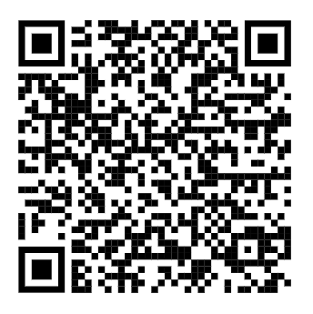
How to Configure Azure Databricks
https://docs.microsoft.com/en-us/azure/machine-learning/service/how-to-configure-environment#azure-databricks

Slide 41
Enterprise deployment

Slide 42
Deploy Azure ML models at scale
Azure Machine Learning Service
Models are optimized to run on the target device
Cognitive Service
Model Registry
Service Dependencies
Container Registry
Model Management
Cloud Service
Machine Learning Pipeline
Heavy Edge
Scoring File Package Dependencies
Packaged Model
Deployment & Model Monitoring
Register Model
Light Edge
External Model

Slide 43
Model deployment
No Neutral Hardware Acceleration
Cognitive Services
Light Edge | Devices
Light Edge | Sensors
Azure Machine Learning Experimentation
Azure Machine Learning
Cloud/HW Accel Cloud
Heavy Edge
Neutral Hardware Acceleration
External Model
Light Edge | Devices
Light Edge | Sensors
Notes:
Deploy models to Azure Kubernetes service with automatic scaling capability
Container-based hosting for improved time to market
Deploy models to the cloud, on-premises, to IoT edge and to FPGAs
Automatically optimize models to take advantage of new hardware accelerators in edge devices

Slide 44
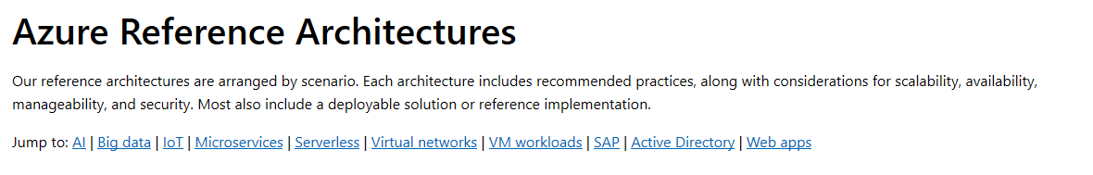

https://docs.microsoft.com/en-us/azure/architecture/reference-architectures/

Slide 45
Action

Slide 46

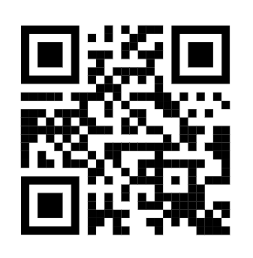

Try it for free http://aka.ms/amlfree
Learn more : https://aka.ms/automatedmldocs
Notebook Samples : https://aka.ms/automatedmlsamples
Blog Post : https://aka.ms/AutomatedML
Product Feedback : AskAutomatedML@microsoft.com
Notes:
Choose between visual drag-and-drop or code-first authoring with complete control
Use your favorite IDE, built into your favorite IDE (VS Code only @ Public Preview)
Use any framework or library and the most popular languages
Faster, easier training on industry leading Spark

